Slide 1
Top NYC Zip codes to Invest in!
Minoo Taghavi

Slide 2

Introduction
Task
Investigating short term rental properties in NYC
Methods
Return on Investment

Slide 3

The best NYC Zip-codes for Investment
Problem Statement
Pay with Cash
No Inflation Rate
75% Occupancy
Homogeneous Locale
Two-bedroom Properties

Slide 4

Exploratory Data Analysis
1- Importing Libraries
2- Importing Datasets
3- Cleaning the Datasets
4- Analyzing Relationship Between Variables
Airbnb Dataset (48895, 106)
Zillow Dataset (8946, 262)
Removing Redundant Variables
Feature Selection
Removing Outliers
Nulls Imputations

Slide 5
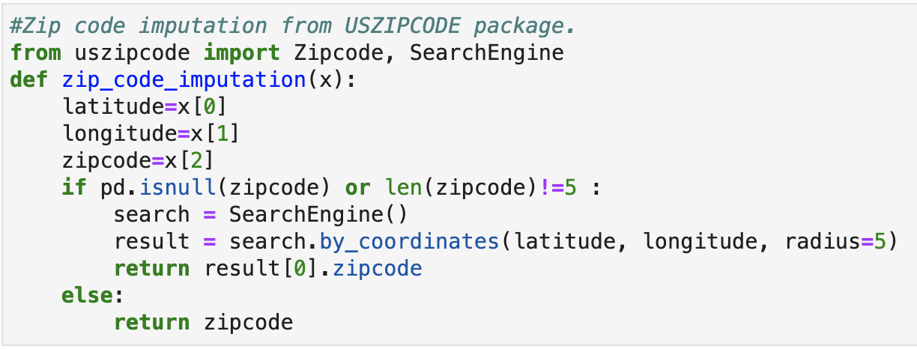
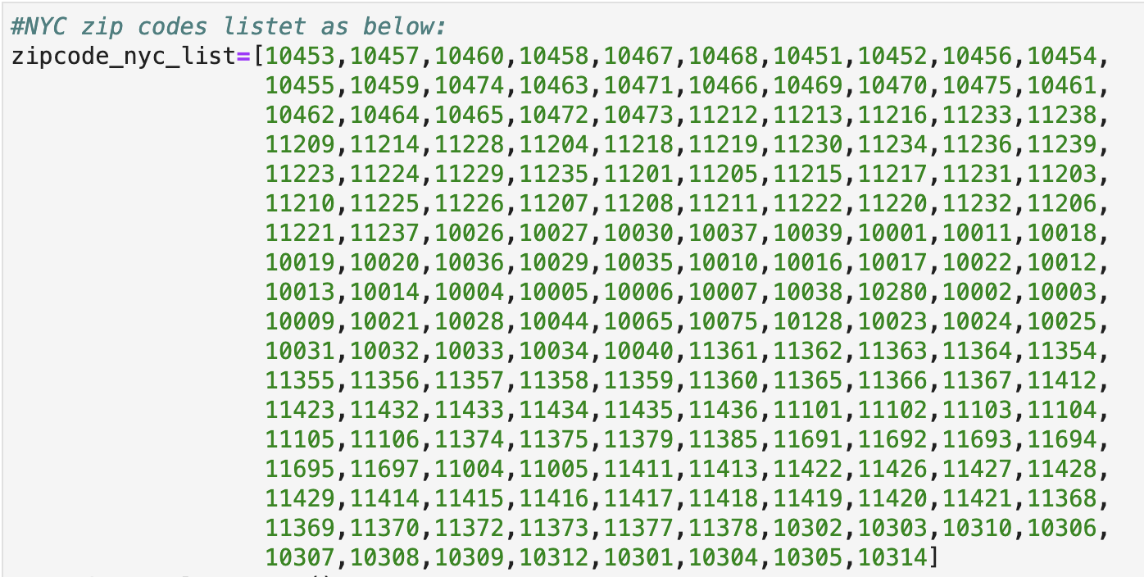
EDA– Data Management
Zip codes Imputation
List of NYC Zip codes

Slide 6
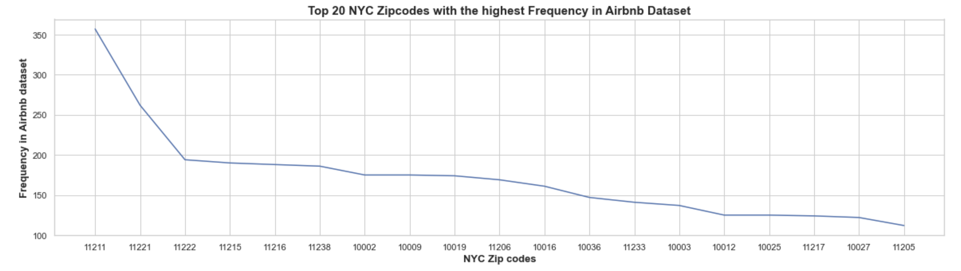
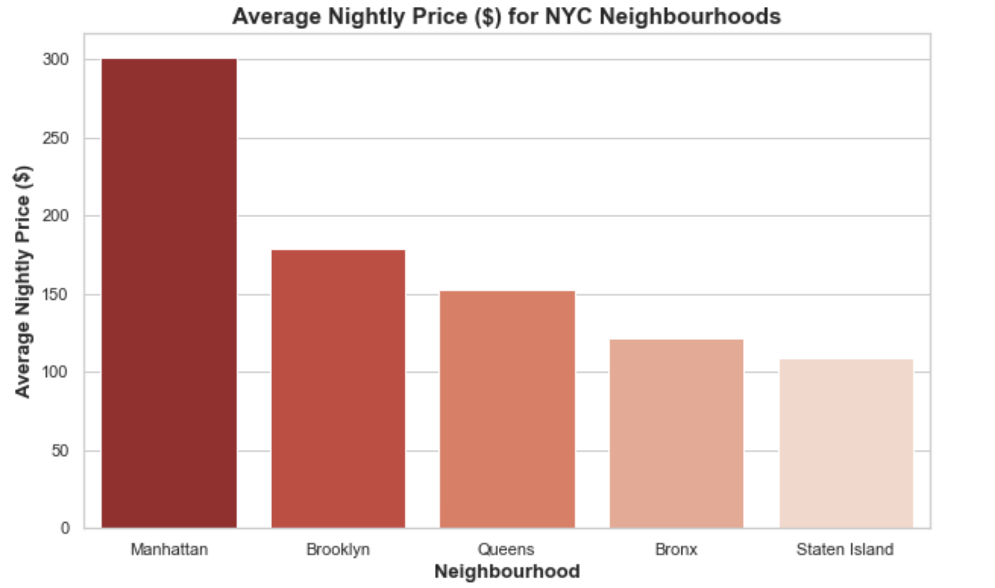
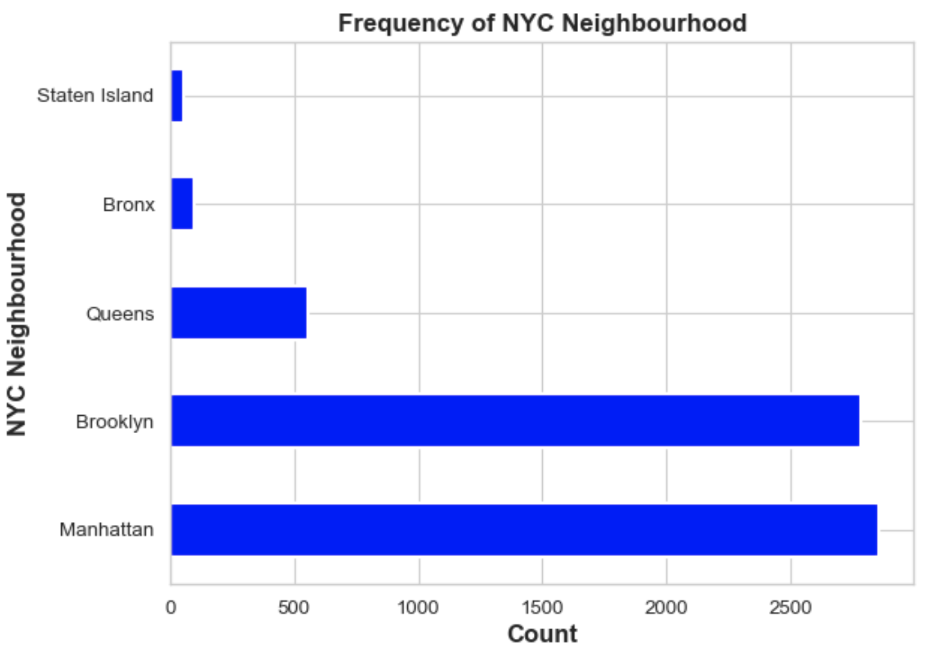
Analysis of Airbnb Data set

Slide 7
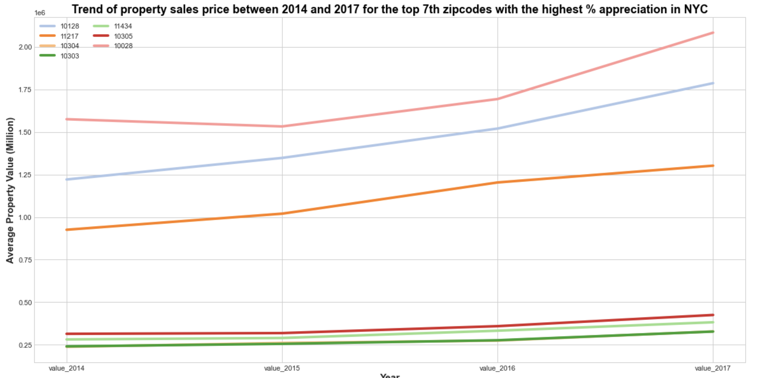
Property Sales Price Trend with the Highest % Appreciation
32%
46%
41%
35%
36%
36%
Year

Slide 8
Feature Engineering
Average Annual Occupancy =
365* 0.75
Annual Rental Income =
Price * Average Annual Occupancy
Property Value Appreciation Rate =
(( (House Value 2017/ House Value 2014)^^{(1/3)})-1)*100
FV = PV * (1+i) ^{n}
FV: future value
PV: past value
i: annual appreciation rate
n: number of years

Slide 9
Developed Metrics after Merging
Payback Period = House Value 2017/ Annual Rental Income
ROI = (Annual Rental Income / House Value 2017 )*100
Total Expected ROI = ROI + Property Value Appreciation Rate
Expected Payback Period = 100 / Total Expected ROI

Slide 10
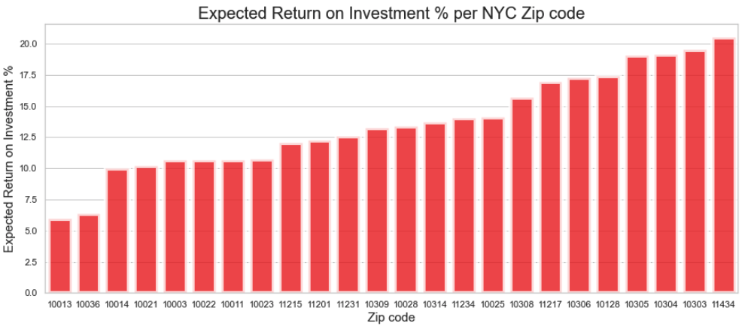
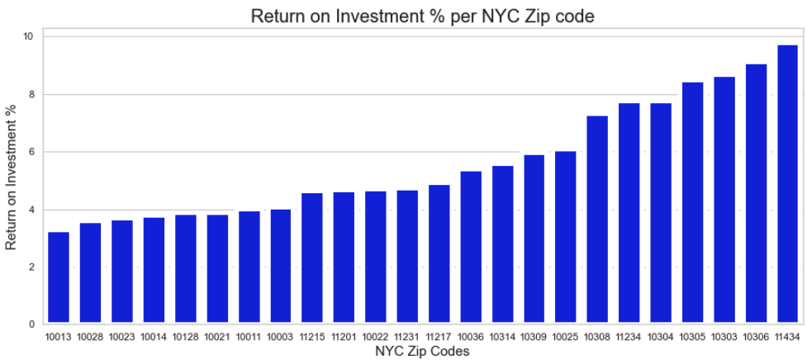

Expected ROI % vs. ROI % per Zip code

Slide 11
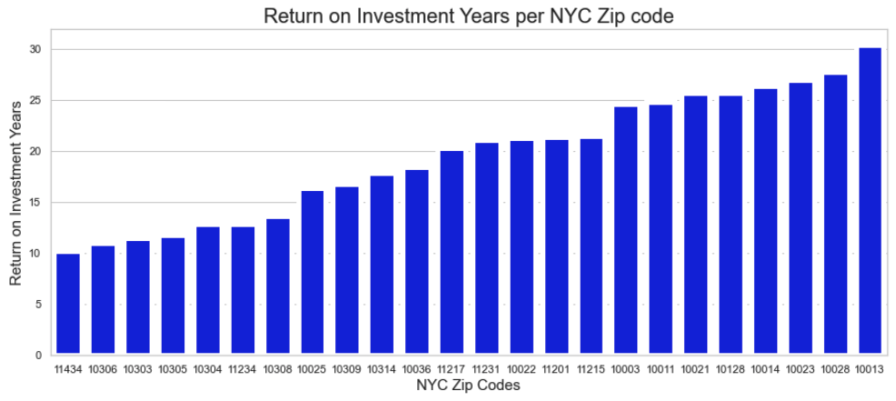
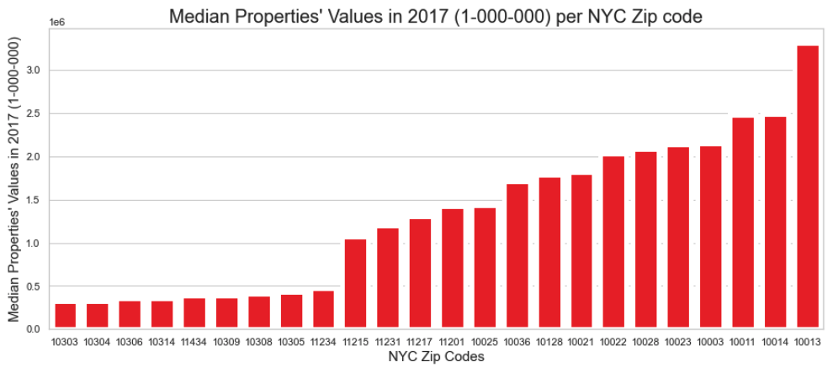
Median 2017 Properties’ Values vs. Payback Period per Zio code

Slide 12
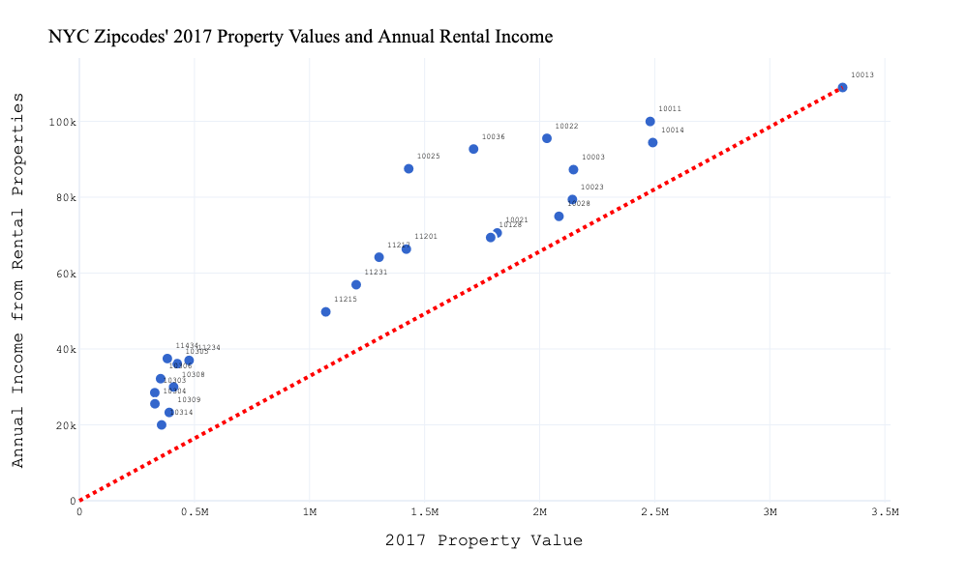
Feature Correlations NYC Zip codes' 2017 Property Values and Annual Rental Income

Slide 13
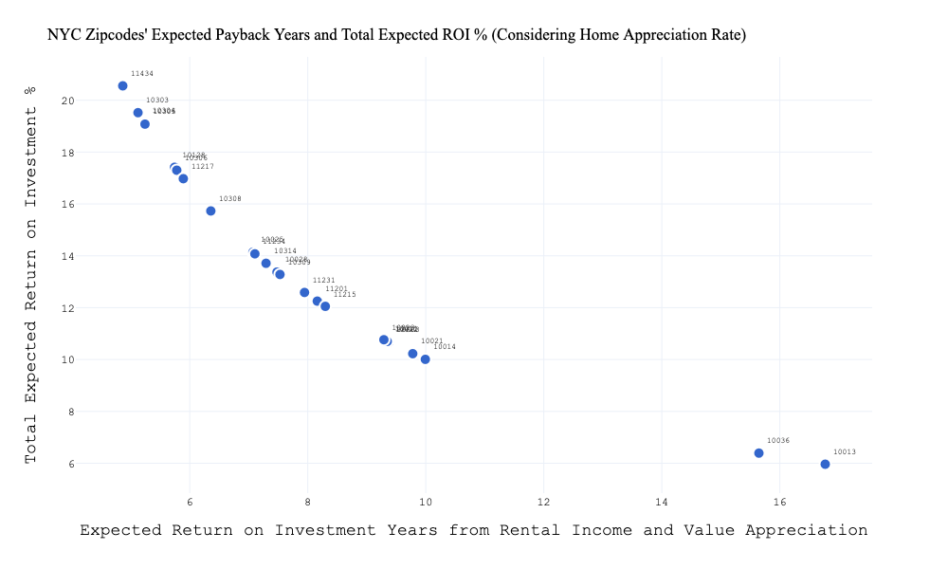
NYC Zip codes' Expected Payback Years and Total Expected ROI % (Considering Home Appreciation Rate)

Slide 14
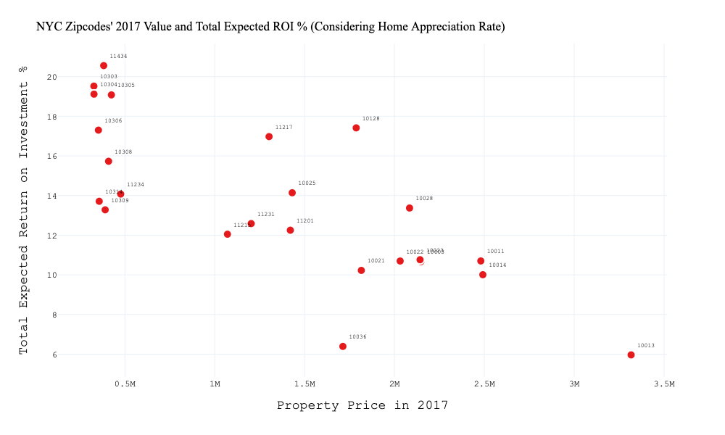
NYC Zip codes' 2017 Value and Total Expected ROI % (Considering Home Appreciation Rate)

Slide 15
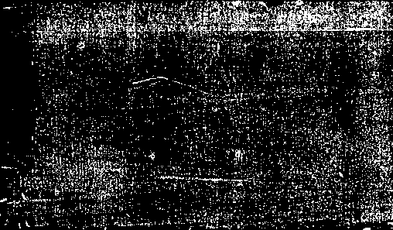
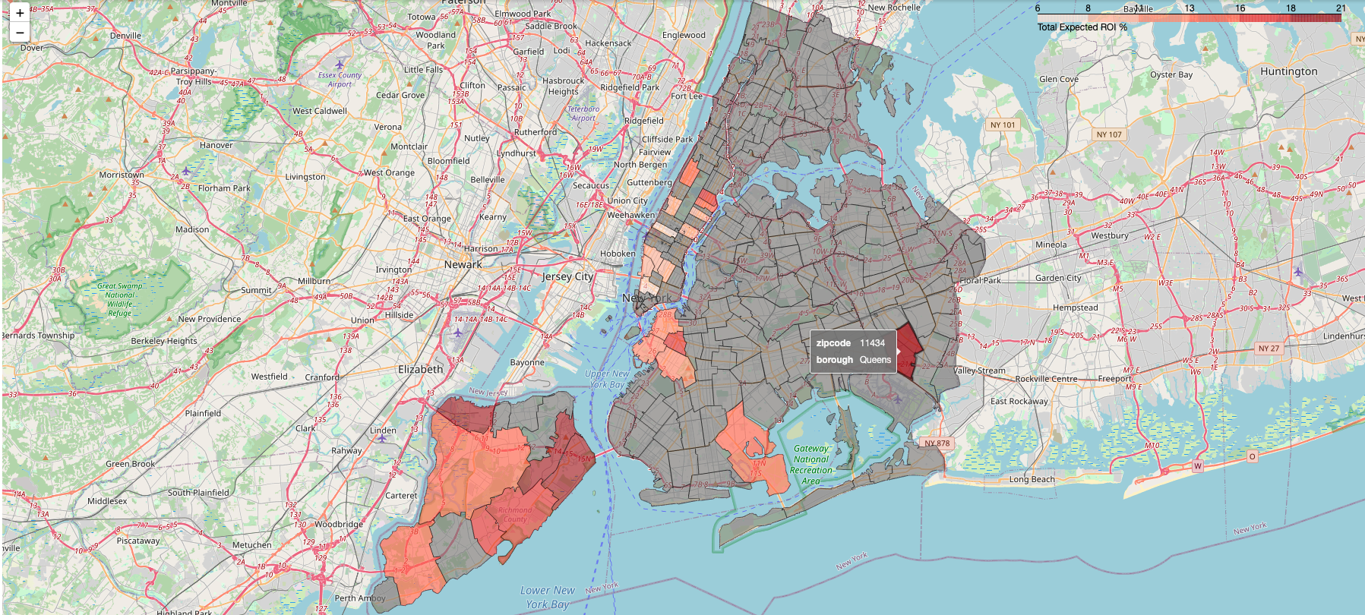
Final Result

Slide 16
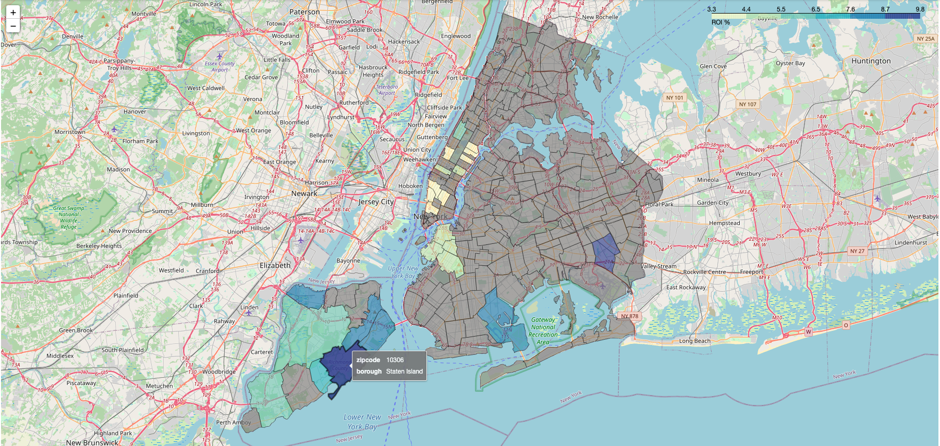
Final Result

Slide 17
Final Insights
Zip codes 11434, 10303, and 10304 are respectively expected to have the highest rate of return on investment.
Zip codes with the highest expected ROI are located in Queens and Staten Island neighborhoods.
The results suggest that generally, rental properties located in zip codes with lower prices outside of the densely populated neighborhoods have the highest potential Return on Investment.

Slide 18
Further Investigations
The Actual occupancy rates for different zip codes?
Which zip codes tend to favor shorter or longer (nightly, weekly and monthly) rental periods and how that would affect the rental income?
How does population density of the area affect property prices, rental prices, and occupancy rates?
How does proximity to the attractions or ease of access to public transportation affect property prices, rental prices, rental periods, and occupancy rates?
What is the effect of taxes, fees, and maintenance costs on the net rental income (net ROI) and how do these expenditures change with the change of property value and location?
Additional data on average percent increase in rental prices for each zip code.

Slide 19


